Slide 1
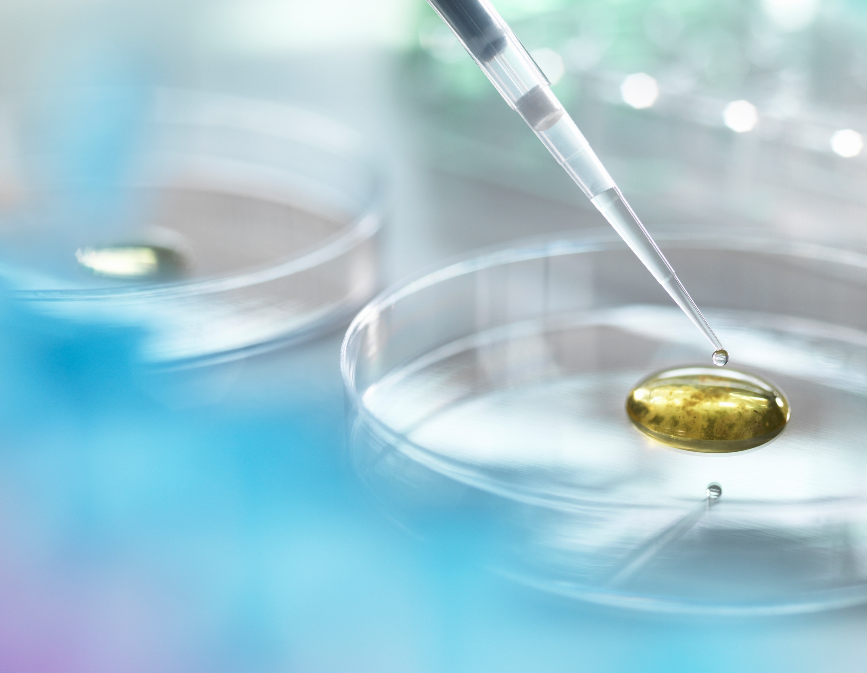
Cataract detection USING DEEP CONVOLUTIONAL NEURAL NETWORKS
PRESENTED BY: REJIT MUKHERJEE
USN: PES2PGE20DS194
Internal Guide: Dr. Sagarika Bora
External guide: Mr. Pradeep Madhavankutty

Slide 2
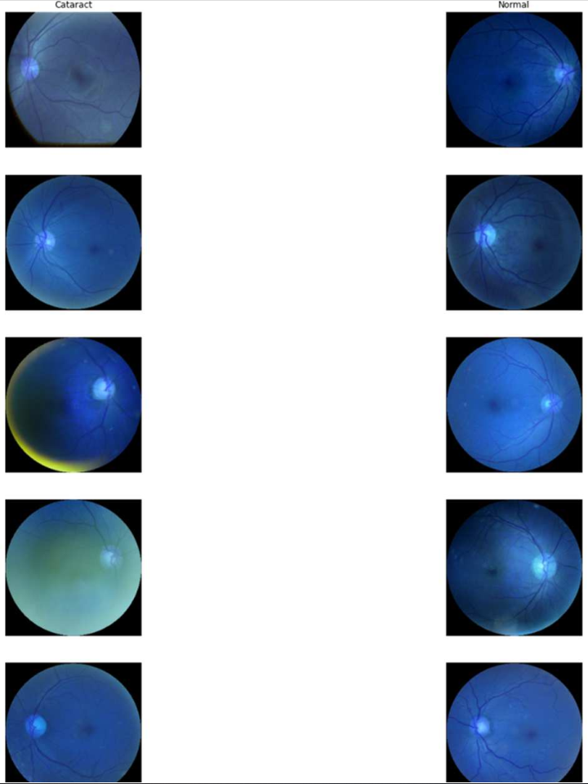
Abstract
Cataract is one of the most prevalent causes of blindness in the modern society, accounting for 50% of blindness. According to a survey done by WHO/NPCB there is a backlog of over 22 million blind eyes (12 million blind people) in India. 80.1% of these are blind due to cataract. The annual incidence of cataract blindness is about 3.8 million. Early detection and treatment can reduce the suffering and prevent visual impairment from turning into blindness. But the expertise needed for early detection and grading is down to availability of expert trained eye specialist which may not be available in rural parts of the country. Existing studies on automatic detection and grading based on fundus images utilizes a predefined set of images provide an incomplete, redundant or noisy representation. In this project, the aim is to use Deep Convolutional Neural Network (DCNN) to detect and grade cataract automatically. This will help in early detection of cataract even without the presence of an trained eye specialist in some of the remote parts of the country.

Slide 3
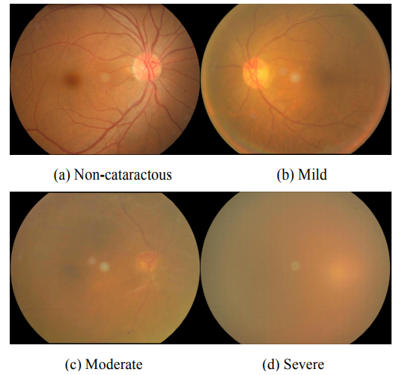
OBJECTIVE: Cataract Detection and Grading using Deep Convolutional Neural Network.
RATIONALE: The Rationale to opt for this Topic:
-> Early Detection and treatment for Cataract.
-> Prevention from permanent blindness.
PROBLEM STATEMENT:
Cataract is the lead cause of blindness in the country and worldwide accounting for 80.1% in India and 50% around the world. Lack of trained expert in remote locations makes it difficult to detect and treat cataract, using DCNN to create an automated detection and grading model would help in reducing the chances of blindness to people even in the most remote parts of the world/country where presence of trained expert is not possible.

Slide 4
LITERATURE SURVEY
AUTHORS | CITATION | PRE-PROCESSING | REVIEW
Linglin Zhang, Jianqiang Li, i Zhang, He Hana, Bo Liua, Jijiang Yangc, Qing Wang | Automatic Cataract Detection And Grading Using Deep Convolutional Neural Network | Unify fundus images and Erase patients personal information | Deep Convolutional Neural Network and visualize some feature maps at pool5 layer.
Jocelyn Hui Lin Goh, Zhi Wei Lim, Xiaoling Fang, Ayesha Anees, Simon Nusinovici, Tyler Hyungtaek Rim, Ching-Yu Cheng, Yih-Chung Tham | Artificial Intelligence for Cataract Detection and Management | Excluding ungradable photos and photos with error in lens location detection. | Application of AI for the IOL power calculation.
Xinting Gao, Stephen Lin, Tien Yin Wong | Automatic Feature Learning to Grade Nuclear Cataracts Based on Deep Learning | Adopt the deep learning framework based on convolutional-recursive neural networks (CRNN). | Proposed a new method for nuclear cataract grading based on automatic feature learning
Md. Sajjad Mahmud Khan, Mahiuddin Ahmed, Raseduz Zaman Rasel, Dr. Mohammad Monirujjaman Khan | Cataract Detection Using Convolutional Neural Network with VGG-19 Model | Filtered out all fundus images other than Cataract and Normal Fundus Images | Automated cataract detection system utilizing convolutional neural networks with transfer learning approach
Masum Shah Junayed, MD Baharul Islam, Arezoo Sadeghzadeh, Saimunur Rahman | CataractNet: An Automated Cataract Detection System Using Deep Learning for Fundus Images | The images are resized to a unified format with 224 × 224 pixels. | Presented an automated cataract detection system, namely CataractNet, based on lightweight deep learning

Slide 5
Expected outcome
Deep convolutional neural network has recently been applied to image classification with large image datasets. A deep CNN is able to learn basic filters automatically and combine them hierarchically to enable the description of latent concepts for pattern recognition.
The expectations from this method is to get record breaking Accuracy and time efficiency. Through DCNN, discriminative features that characterize high level information are extracted effectively and automatically, rather than artificially. Furthermore, the feature extraction and classifier combined demonstrates a higher level of intelligence. This approach has been confirmed to great practical significance in early cataract screening and diagnosis and has great scope of being applied in other eye related diseases.

Slide 6
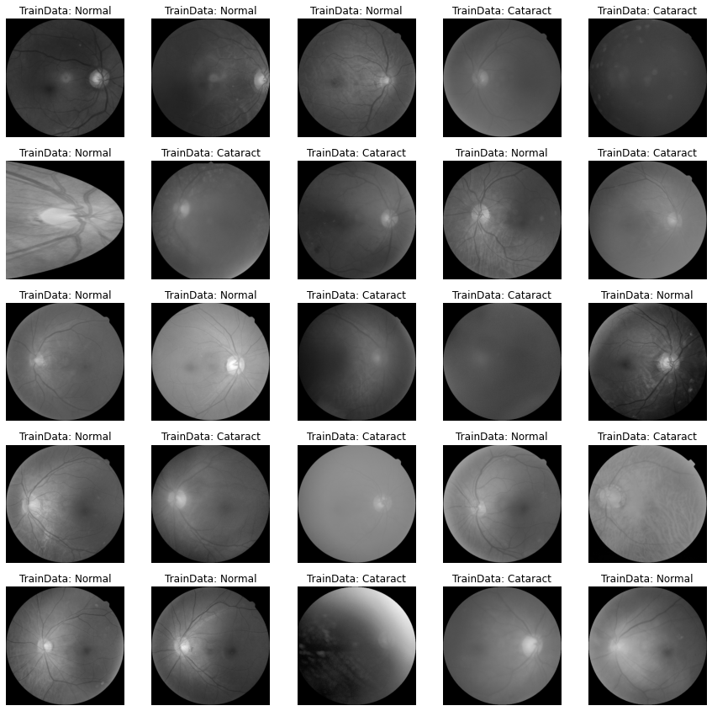
dataset
This project makes use of 2 datasets containing Retina Fundus Images for different Eye Diseases ranging from Cataract, Diabetic Retinopathy and so on. For my project I’m going to filter out the Cataract and Normal Fundus Images from the 2 datasets, combining them to create a singular dataset, preprocess them and create a filtered out final folder for further analysis in the future on different models.
Final Pre-processed dataset

Slide 7
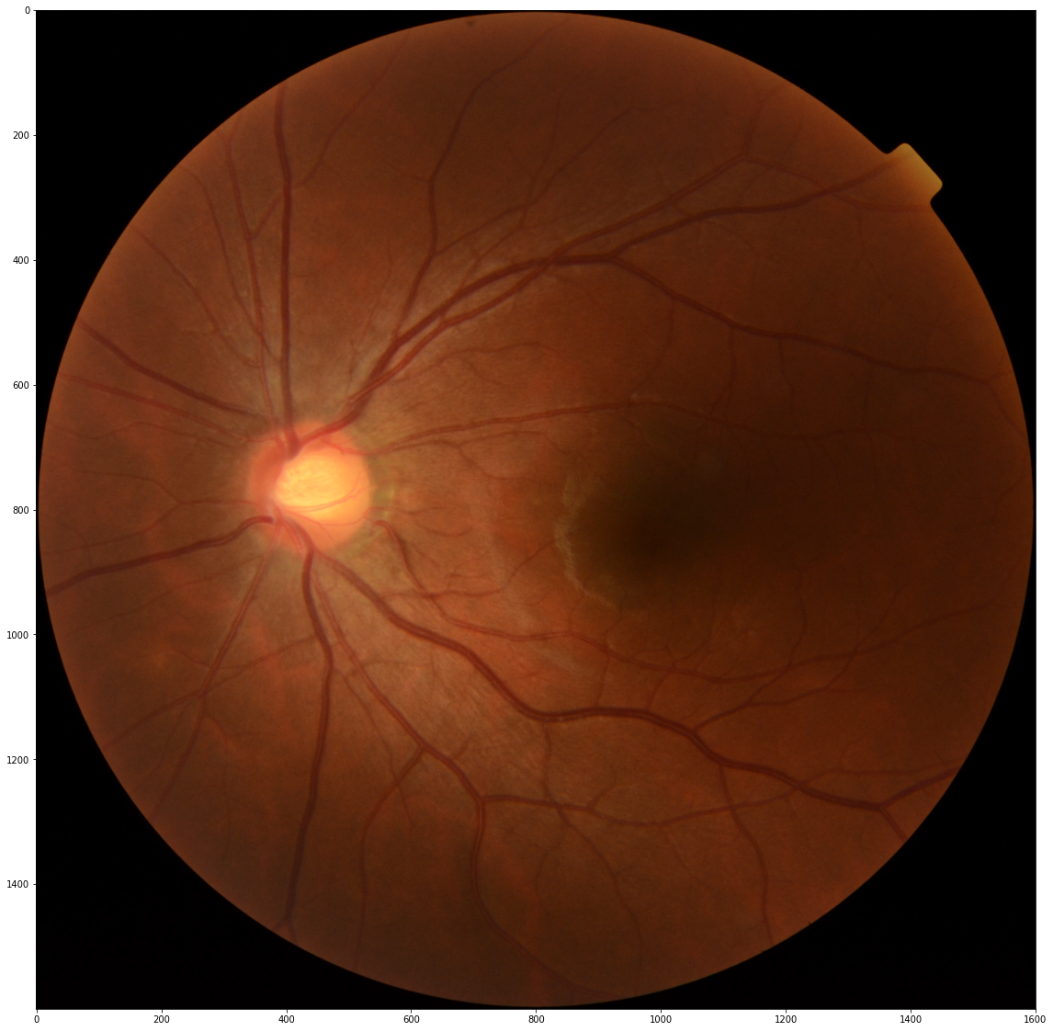
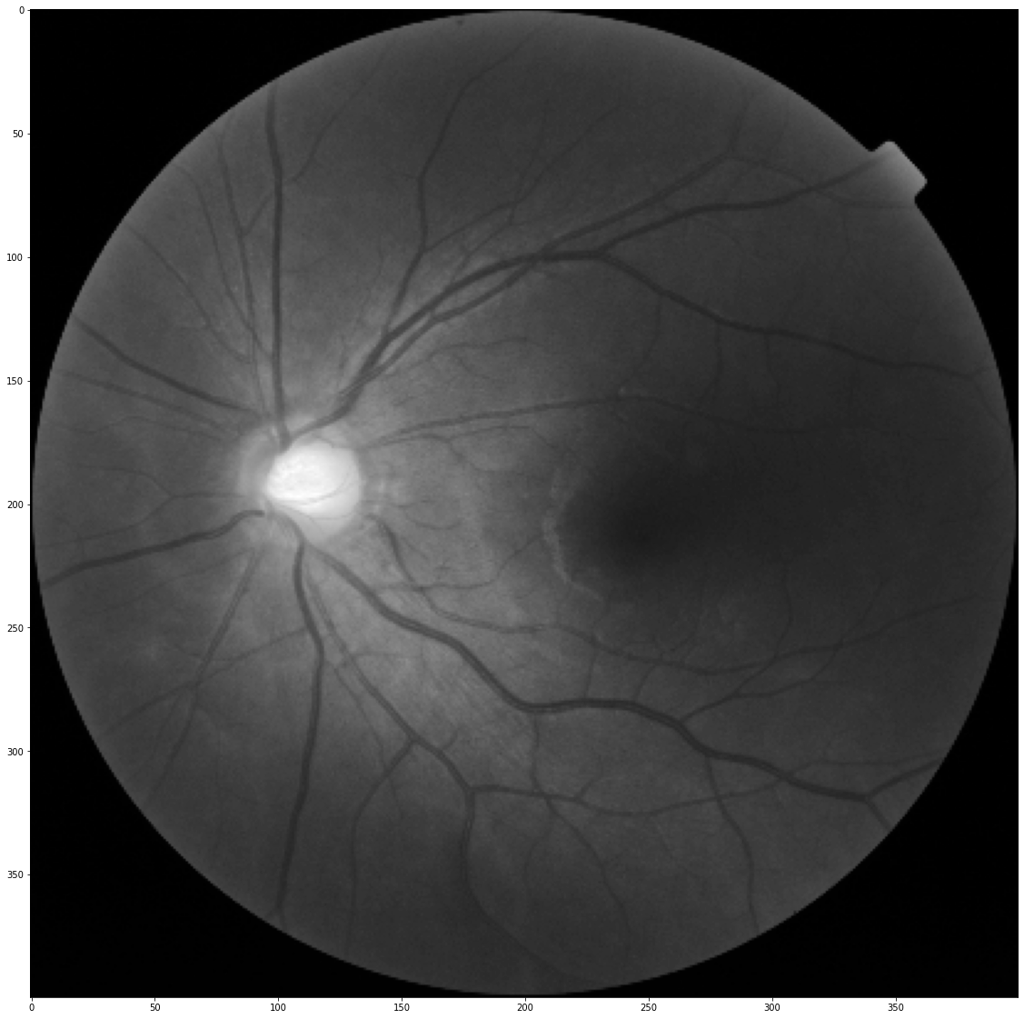
Algorithms and techniques
PREPROCESSING: Image Preprocessing is the first step taken, Images are reshaped and converted to G-Channel.
DEEP NEURAL NETWORK: For our problem we will deploy DCNN with eight layers, the first five will be convolutional layers and the remaining three layers will be fully connected layers. The output of the last fully connected layer will be fed to a four-way SoftMax which produces a distribution over the four class labels.

Slide 8
PROPOSED METHODOLOGY
DATASET:
For this project, I’ve used 2 datasets containing 1201 and 8000 Retina Fundus Images each of varying Eye Diseases and that of a normal human Eye. I’ve combined the datasets and extracted out 1026 images (613 Normal Eye, 413 Cataract).
PRE-PROCESSING:
Based on past research on this topic, it was found out that Retina Fundus Images have illumination issues while training a model which hinders the final accuracy of the model, to tackle that, it was found that converting the Images to G-Channel helps tackling the illumination and helps with the overall accuracy of the model. In this step I also resized the images to a lower resolution to find out the accuracy of the model on a lower resolution model due to incapacity of the system.
DCNN ARCHITECTURE:
The DCNN Architecture presented consists of 8 Layers, 5 Layers of Convolutional Neural Networks and the remaining 3 Layers of Fully Connected Networks. The output of the last fully connected layer consists of a 2 way softmax which produces a distribution over the 2 class labels (Normal and Cataract). The Image Pre-Processed to the G-Filter is passed through the layers. Each layer consists of several 2D feature maps where each feature map often capturing specific aspect of the image such as the color, object category, or attributes, while preserving the spatial information at coarse resolution. For instance, pool5 layer consists of 256 feature maps where the resolution of each is 6×6. Therefore, the feature maps at this layer preserves spatial information at the resolution of 6×6. While earlier layers captures rudimentary concepts such as lines, circles, and stripes, the feature maps in deeper layers can identify more high-order concepts.

Slide 9
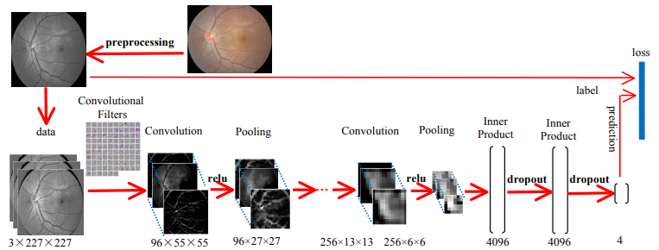
Architectural design of the proposed system
2
4

Slide 10
PROJECT PROGRESS
In this project, I have tried to execute 2 models of different layer count for Convolutional Layers and Fully Connected Layers. The first model with a total of 69,490 params (69,426 Trainable and 64 Non-Trainable Params) give a train accuracy of 65.27% and a test accuracy of 59.71%, Running this same model on a more efficient system with variable resolution of the images, the same model gives an accuracy of 89.24% on train data and 88.35% accuracy on test data. The 2nd Model was a pre-trained model with total param of 4,052,126 (4,010,110 Trainable and 42,016 Non-Trainable Params). This Model was ran on the more efficient system and gave a train data accuracy of 92.40% and 93.20% on the test data.
The Model that the architecture was explained on is based on a pre-existing research that yields the best accuracy for any cataract detection models so far but that model needs higher system specifications due to it being having high image resolutions of 1600x1600 as compared to the image resolution I have worked on in the initial 2 models. With the access of higher specification system, I hope to run models of contain higher params and resolution images since the deeper the layer of the DCNN, the more the model is able to train itself yielding accuracies of over 95%.

Slide 11
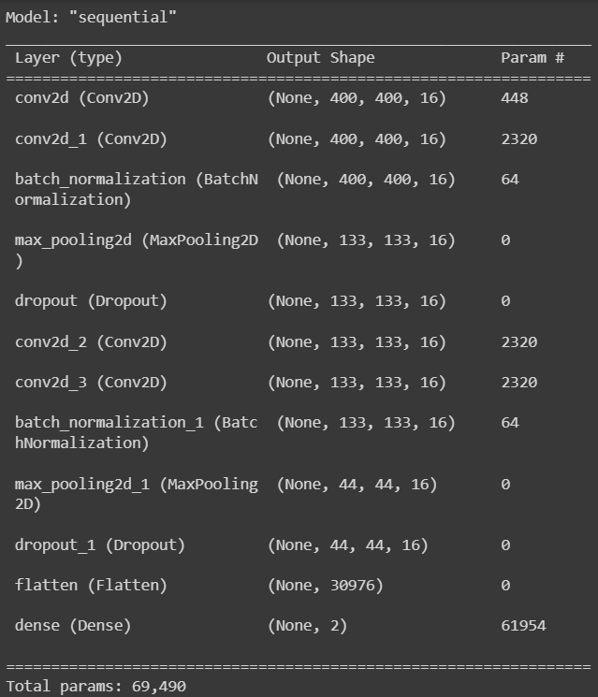
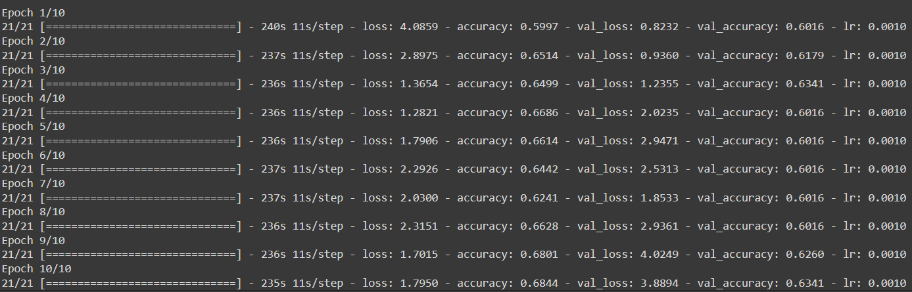
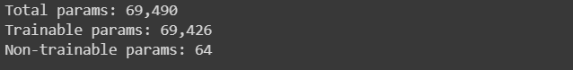
RESULTS OF PHASE-1
Model “Sequential” training
Model “Sequential” test
Summary of Model 1 “Sequential”

Slide 12
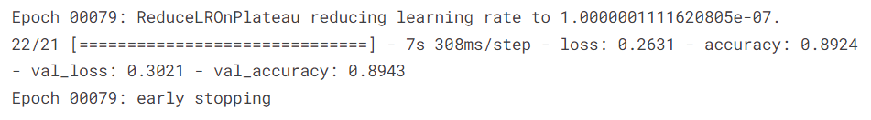
Train
Test
Model “Sequential” train and test performance on a higher specification system.

Slide 13
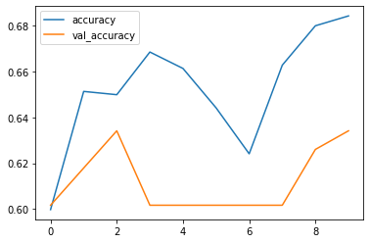
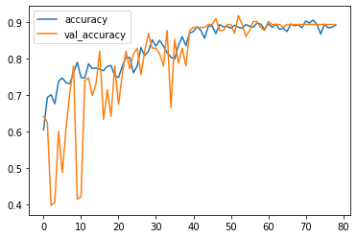
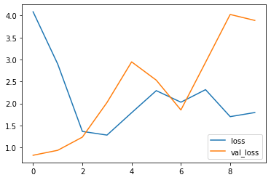
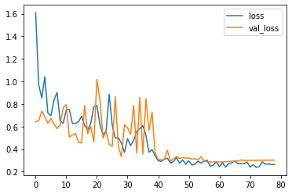
Model “Sequential” performance on a low specification system vs a higher spec system

Slide 14
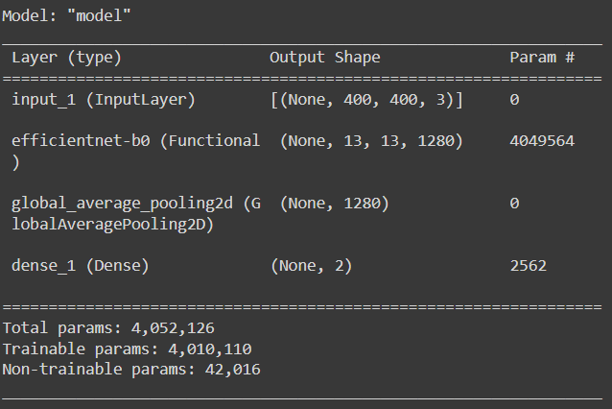
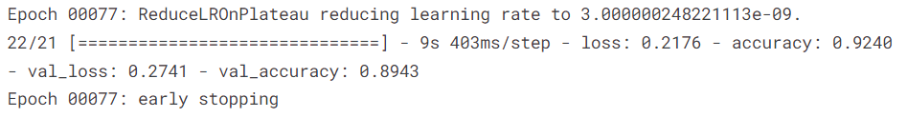
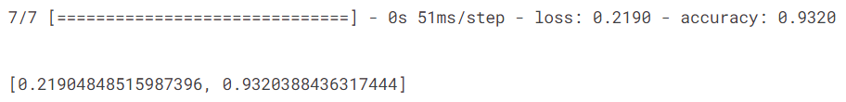
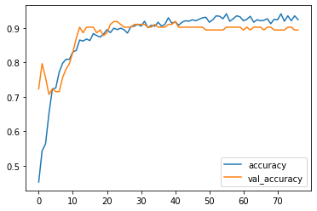
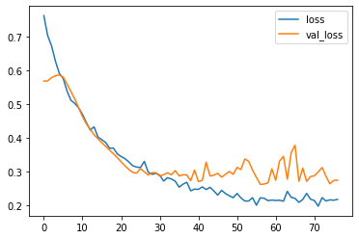
Train and Test Accuracies
Pre-Trained Model 2
Model Performance on Train Data

Slide 15
Phase-2 Model details
Model No. | Model Name | Model Type | Total Params | Accuracy
1 | - | Self-Trained | 101,942,850 | Train: 78.48%, Test: 77.67%
2 | EfficientNetB0 | Pre-Trained | 4,052,126 | Train: 93.26%, Test: 88.35%
3 | VGG-16 | Pre-Trained | 14,715,714 | Train: 93.69%, Test: 92.72%
4 | Inception_V3 | Pre-Trained | 21,806,882 | Train: 99.00%, Test: 91.75%
5 | ResNet50 | Pre-Trained | 23,591,810 | Train: 63.99%, Test: 68.93%
6 | MobileNet | Pre-Trained | 3,230,914 | Train: 97.13%, Test: 93.20%
7 | MobileNet_V2 | Pre-Trained | 2,260,546 | Train: 40.46%, Test: 41.26%
8 | VGG-19 | Pre-Trained | 20,025,410 | Train: 94.69%, Test: 93.20%
9 | Xception | Pre-Trained | 20,865,578 | Train: 96.99%, Test: 93.69%
10 | - | Self-Trained | 130,958,586 | Train: 88.67%, Test: 86.69%

Slide 16
Model No. | Model Name | Model Type | Total Params | Accuracy
11 | ResNet152 | Pre-Trained | 58,375,042 | Train: 40.03%, Test: 40.29%
12 | ResNet101 | Pre-Trained | 42,662,274 | Train: 59.83%, Test: 59.71%
13 | InceptionResNetV2 | Pre-Trained | 54,339,810 | Train: 97.85%, Test: 91.75%
14 | DenseNet201 | Pre-Trained | 18,325,826 | Train: 99.43%, Test: 93.69%
15 | DenseNet169 | Pre-Trained | 12,646,210 | Train: 95.84%, Test: 92.72%
16 | DenseNet121 | Pre-Trained | 7,039,554 | Train: 98.85%, Test: 92.23%
17 | EfficientNetB1 | Pre-Trained | 6,577,794 | Train: 96.70%, Test: 92.72%
18 | EfficientNetB2 | Pre-Trained | 7,771,380 | Train: 87.66%, Test: 90.26%
19 | EfficientNetB3 | Pre-Trained | 10,786,602 | Train: 96.84%, Test: 92.72%
20 | EfficientNetB4 | Pre-Trained | 17,677,402 | Train: 97.99%, Test: 92.72%

Slide 17
References
1. Linglin Zhang et al., "Automatic cataract detection and grading using Deep Convolutional Neural Network," 2017 IEEE 14th International Conference on Networking, Sensing and Control (ICNSC), 2017.
2. Y. Dong, Q. Zhang, Z. Qiao and J. Yang, "Classification of cataract fundus image based on deep learning," 2017 IEEE International Conference on Imaging Systems and Techniques (IST), 2017, pp. 1-5, doi: 10.1109/IST.2017.8261463.
3. X. Gao, S. Lin and T. Y. Wong, "Automatic Feature Learning to Grade Nuclear Cataracts Based on Deep Learning," in IEEE Transactions on Biomedical Engineering, vol. 62, no. 11, pp. 2693-2701, Nov. 2015, doi: 10.1109/TBME.2015.2444389.
4. M. S. Mahmud Khan, M. Ahmed, R. Z. Rasel and M. Monirujjaman Khan, "Cataract Detection Using Convolutional Neural Network with VGG-19 Model," 2021 IEEE World AI IoT Congress (AIIoT), 2021, pp. 0209-0212, doi: 10.1109/AIIoT52608.2021.9454244.
5. M. S. Junayed, M. B. Islam, A. Sadeghzadeh and S. Rahman, "CataractNet: An Automated Cataract Detection System Using Deep Learning for Fundus Images," in IEEE Access, vol. 9, pp. 128799-128808, 2021, doi: 10.1109/ACCESS.2021.3112938.
6. Goh, Jocelyn Hui Lin; Lim, Zhi Wei BSc (Hons); Fang, Xiaoling MD; Anees, Ayesha MSc; Nusinovici, Simon PhD∗; Rim, Tyler Hyungtaek MD, PhD; Cheng, Ching-Yu MD, PhD; Tham, Yih-Chung PhD, Artificial Intelligence for Cataract Detection and Management, Asia-Pacific Journal of Ophthalmology: March-April 2020 - Volume 9 - Issue 2 - p 88-95 doi: 10.1097/01.APO.0000656988.16221.04.

Slide 18


